Slide 1


Appointment of: Founding Master
Wellington College International Lagos, Alaro City, Nigeria

Slide 2
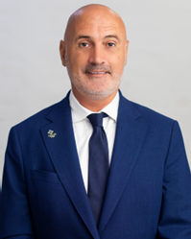

Hiring Invitation Letter
We would like to thank you for your interest in the role of Founding Master of Wellington College International Lagos.
Wellington College International and Rendeavour, Africa’s new city builder, have partnered to open a co-educational day and boarding school for 1,500 pupils aged 2-18 in Alaro City, Lagos, Nigeria. Opening in September 2027, Wellington College International Lagos will offer unparalleled academic excellence, state-of-the-art facilities, and a holistic approach to education, transforming the educational landscape in West Africa.
Africa is the world’s youngest continent — over 60% of its people are under 25. That means energy, creativity, and an unstoppable drive for change. Cities are growing fast, economies are rising, and technology is leapfrogging old systems.
From mobile money to clean energy, from Nollywood to Afrobeats, Africa is shaping global culture and pioneering new solutions. With vast natural resources, renewable energy potential, and the African Continental Free Trade Area unlocking the world’s largest market, Africa isn’t just catching up — it’s leading. The future of Africa is a story of innovation, unity, and possibility — and it’s only just beginning!
This opportunity enables the Founding Master to establish an outstanding school, that is distinctively Wellington but combines the best of Nigerian culture and expertise, to develop a truly unique and pioneering education for Africa. Joining the project in the summer of 2026, the Founding Master will be able to have input and ownership of the vision, SLT recruitment and interior design of the campus.
Wellington College’s vision is to ‘pioneer education to serve and help shape a better world’. We hope this role excites you. If you have the vision, passion and drive to establish and lead our first school, at the beginning of this journey to serve and help shape education in this dynamic continent, then we would be delighted to hear from you.
Scott Bryan
Director of Education
Rendeavour

Slide 3
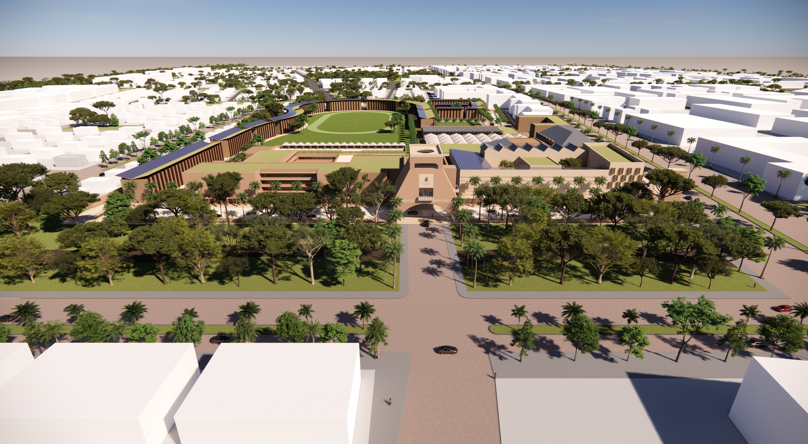
Introduction
Wellington College International and Rendeavour, Africa’s new city builder, have partnered to open a co-educational day and boarding school for 1,500 pupils aged 2-18 in Alaro City, Nigeria.
Opening in September 2027, Wellington College International School Lagos will offer unparalleled academic excellence, state-of-the-art facilities, and a holistic approach to education, transforming the educational landscape in West Africa.
Wellington College International Lagos will share the values, ethos, enduring quality, and ambition of Wellington College, the pioneering British coeducational school, combined with regional and Nigerian educational strengths and traditions.
Rendeavour’s Alaro City campus, developed in partnership with its Nigerian partners and designed by award-winning British architectural design practice MICA Architects, will follow the rigorous English National Curriculum, culminating in the challenging A-level programme, as well as offering coaching and teaching excellence in sports, music, and the arts.
Wellington College is a thought leader in education, and the school will look to lead in areas of AI and entrepreneurship.
Rendeavour is Africa’s largest new city developer. Backed by American, Norwegian, New Zealand, and British investors, Rendeavour’s cities are among the largest construction projects in Africa and serve as hubs for businesses, homes, education, and recreation within infrastructure-ready economic zones.

Slide 4
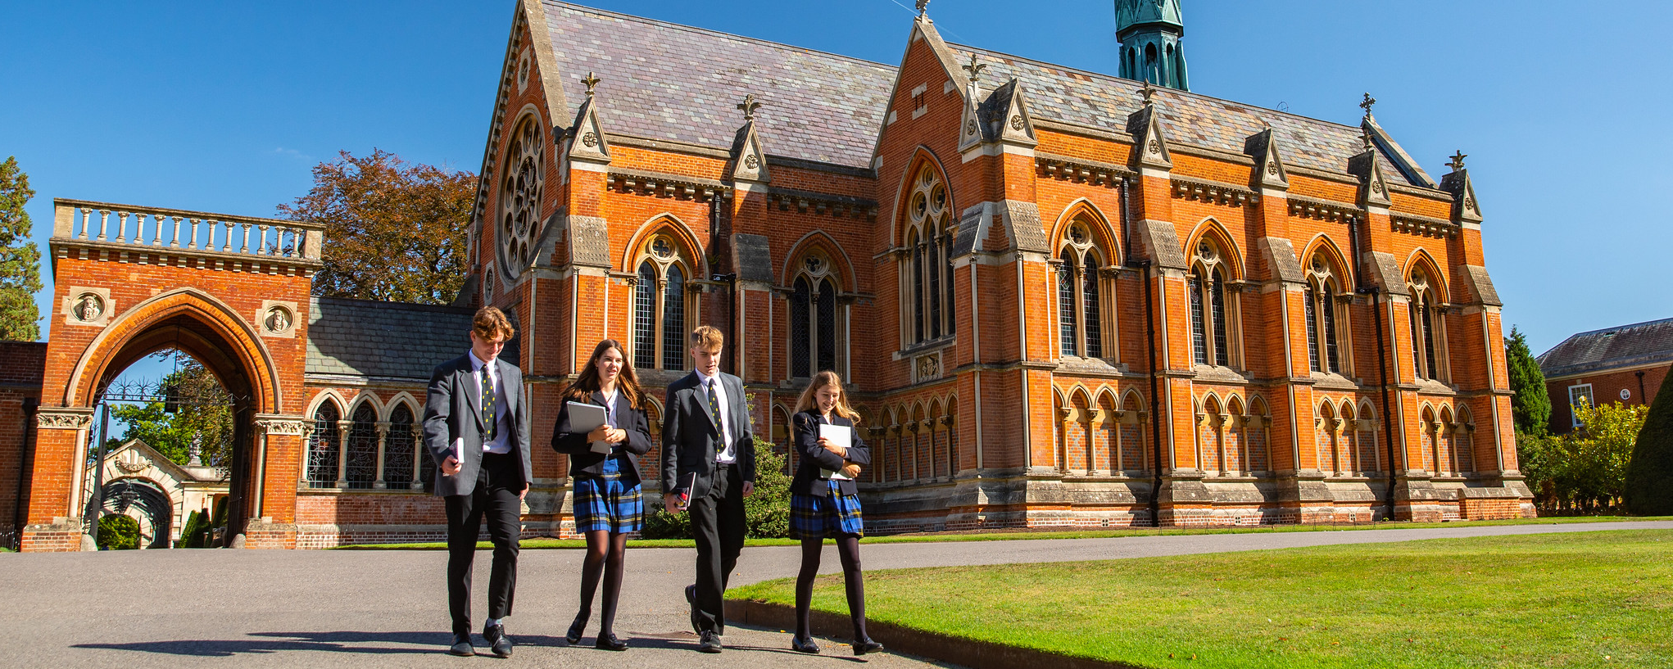
Wellington College
Wellington College is a leading co-educational day and boarding school in Berkshire, set in 400 acres alongside its prep school, Wellington College Prep. Serving over 1,500 pupils aged 3–18, its mission is to pioneer education that helps shape a better world.
Wellington College was granted its Royal Charter in December 1853, with Queen Victoria laying the foundation stone in 1856. It is the national memorial to Britain’s most distinguished military leader, the Duke of Wellington, who was described on his death by Queen Victoria as ‘the greatest Englishman that has ever lived’. Few schools possess such a rich heritage and such a close relationship with the Royal Family. Today, the College is renowned for being an outward-facing school with a strong international perspective.
Wellington College is dynamic in every sense of the word yet is rooted firmly in the five College values: Kindness, Courage, Respect, Integrity, and Responsibility. These values underpin every aspect of life at Wellington. Recruitment of staff, selection of students, policies and practices, and day-to-day decision making are all founded on the five values.
Our educational philosophy is focused on the traits which we would like all Wellingtonians to acquire before taking their place in the adult world.
Our pupils will:
be inspired by everything they do at Wellington, both inside and outside of the classroom, so they leave school as interested and interesting people;
adopt a genuinely intellectual approach to their academic work and to their view of the world around them, in the knowledge that a Wellington education is only the beginning of an exciting and life-long journey of learning;
become truly independent, as those who can think, learn and cope independently so that they will be the leaders and game-changers of the future;
be valued and developed as an individual, so their Wellington experience is much more than just going to school – rather, it is the journey to self; and
be inclusive in all dealings with other people, so they leave the College not in a bubble of privilege and elitism, but with the ability to engage with their local, national and international communities, and with a burning desire to do good in the world.

Slide 5
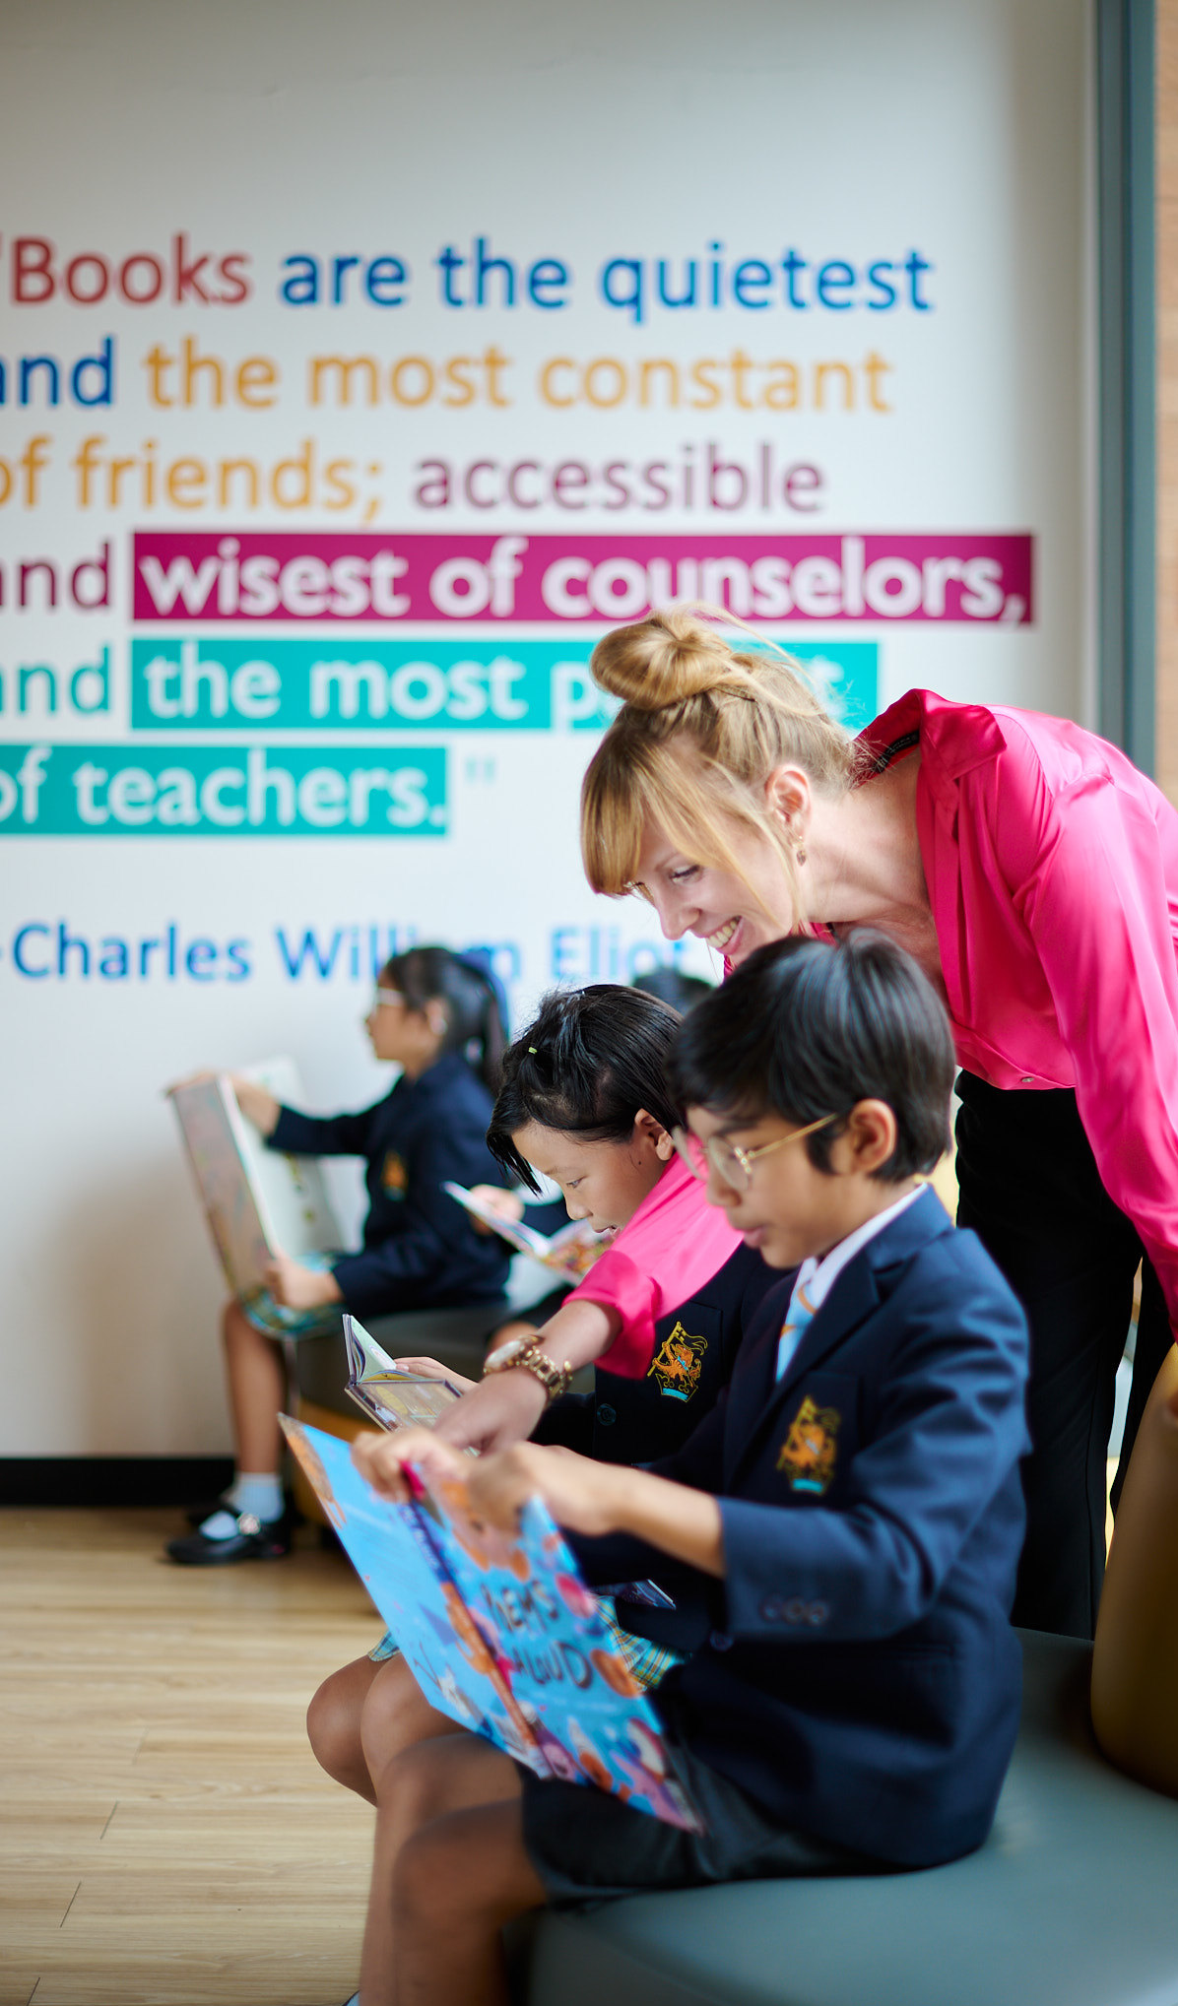
Wellington College Education
Wellington College Education (WCE) is the global educational network of Wellington College, whose purpose is to align and maximise the impact of all our global education activities, directly or through partnership, with the ultimate aim of the whole being significantly greater than the sum of the individual parts. Encompassing eight co-educational schools and approximately 8,000 students around the world, WCE expands educational opportunities, fosters cultural connectivity through leadership, innovation and international collaboration, and empowers young minds.
Wellington College International
Wellington College International (WCI) supports partners with shared values and passion for delivering a ‘Wellington’ education, establishing world class schools in premium locations. There is a strong connection to Wellington College, through frequent staff and student collaborations, proactive sharing of best practice, quality assurance visits and representation of the Governing Board.
Wellington College China
There is currently a family of six schools in China with WCC, located in the cities of Tianjin, Shanghai, Hangzhou and Nantong. Three are International schools, open to international students, and three are bilingual Chinese schools which are open to Chinese nationals. All the schools have bespoke, premium campuses with world-class facilities and deliver a holistic Wellington education with excellent academic outcomes. Alumni of Wellington College China schools now study in the world’s finest universities.
Wellington College International Bangkok
WCI Bangkok was opened in 2018 and benefits from a fine quality and forward-thinking campus, that supports the very best holistic education. In a competitive market and in its short history, Wellington College Bangkok has been awarded the COBIS Patron’s Accreditation (the first school ever to achieve this within its first year of existence) and Membership of CIS.
Wellington College International Pune
WCI Pune is the eighth school to open in the WCI family and the first of several planned for India. It is a co-educational day and boarding school that opened in September 2023 with a capacity for 800 pupils between the ages of 2 and 18.

Slide 6
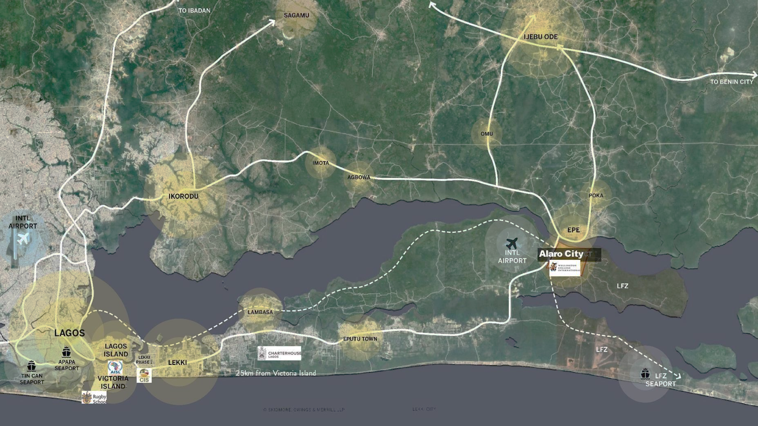
Location: Alaro City, Lagos, Nigeria
With its rich culture and dynamic economy, Lagos is the ideal location for the first school In the Wellington College Education network in Africa. Nigerian parents have a long history of sending their children abroad in pursuit of world-class international education. The school will provide the same standard of excellence, but closer to home.
Alaro City is a thoughtfully designed urban development envisioned on 2,000 hectares, with dedicated space for commercial, industrial, and residential use – including offices, logistics and warehousing, homes, schools, healthcare facilities, hotels entertainment hubs, and 150 hectares of green and recreational areas.
Strategically situated just 45 minutes from Victoria Island, Lagos, it lies opposite the site of the upcoming Lagos International Airport. Alaro City also features the largest residential development within the Lekki Free Zone.

Slide 7
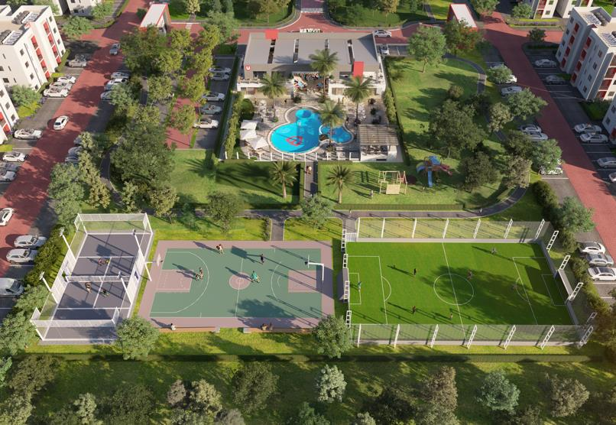
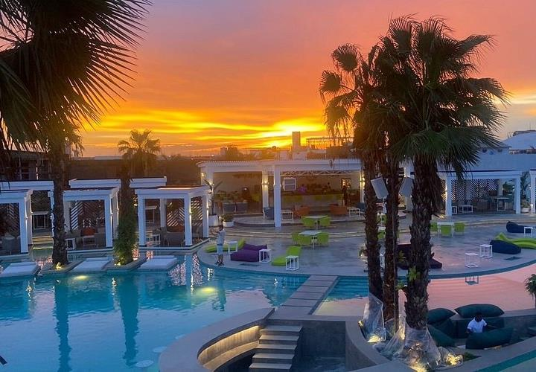


Explore Alaro City
Alaro City is committed to creating a vibrant, secure, and enriching environment for teachers and their families.
Features will include a beach club, leisure centre, retail outlets, and dedicated recreational facilities. We are actively identifying locations for outdoor experiences such as zip lining and bush park.
Alaro City is a 25-minute drive from the Atlantic Ocean, with access to beautiful beach clubs, golf resorts, and other leisure destinations.
Safety is a core priority: Lagos State is widely recognised as the safest State in Nigeria, with the Lekki Free Zone – where Alaro City is located – offering the highest level of security in the State. Alaro City further enhances this with its own integrated infrastructure and private security.
Together, these elements make Alaro City an inspiring and supportive place to live and work.
Universal Homes Leisure Park in Alaro City
Beach Club 30 min from Alaro City
Ziplining Project in Alaro City
Golf Resort 25min from Alaro City

Slide 8
Role and Job Specification
Position Overview
The Founding Master (Headteacher) will provide visionary leadership, strategic direction, and operational oversight in establishing Wellington College International Lagos as the leading international, co-educational boarding and day school in West Africa.
This role requires an entrepreneurial educator with a proven track record of school leadership, an ability to develop world-class teaching and learning, and the skills to build a thriving community from inception.
The Master will initially report to the Director of Education (during the pre-opening phase) and then the Board of Governors (from opening) and will be responsible for the overall academic, operational, pastoral, and financial performance of the school.
Master is also an ex officio, non-voting member of the school’s Board of Governors.
Key Responsibilities
Strategic Leadership
Articulate a vision that combines Wellington’s brand strengths with Nigerian expertise and culture, to develop a truly unique and pioneering school for Africa.
Lead the design, establishment, and growth of the school, ensuring alignment with Wellington’s vision, mission, and values.
Develop and implement the school’s founding strategy, policies, and structures.
Establish a culture of high expectations, innovation, and inclusivity for students and staff.
Build strong relationships with the Board, parents, external partners, and the wider community.
Ensure the school meets international accreditation standards and local regulatory requirements.
Academic Excellence
Design and implement a rigorous, curriculum that prepares students for success at A level and entry to the leading global universities, including Oxbridge and Ivy League.
Recruit, mentor, and retain a diverse, high-performing teaching faculty.
Establish systems for assessment, reporting, and academic monitoring to ensure excellent student outcomes.
Champion innovative pedagogies, technology integration, and continuous improvement in teaching and learning.

Slide 9

Key Responsibilities
Pastoral & Boarding Leadership
Create a safe, nurturing, and inclusive environment where students feel supported academically, emotionally, and socially.
Oversee the boarding programme, ensuring exceptional standards of care, safeguarding, and personal development.
Promote co-curricular programmes (sports, arts, leadership, service) that enrich students’ experiences.
Foster a global outlook, intercultural understanding, and respect for diversity across the community.
Operational & Financial Management
Work with the Board to set and manage the school’s budget and ensure long-term financial sustainability.
Oversee facilities planning, campus development, and day-to-day operations.
Implement robust safeguarding, health & safety, and compliance procedures.
Ensure efficient systems for admissions, marketing, and student recruitment to build enrolment.
Community & Stakeholder Engagement
Act as the ambassador for the school with parents, prospective families, government agencies, and international organisations.
Build partnerships with universities, cultural institutions, and the Wellington College Education global network.
Communicate effectively with all stakeholders to promote trust, transparency, and a sense of shared purpose.

Slide 10
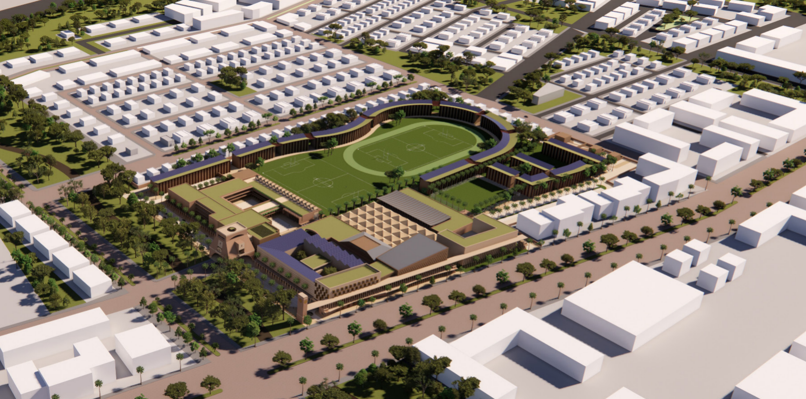
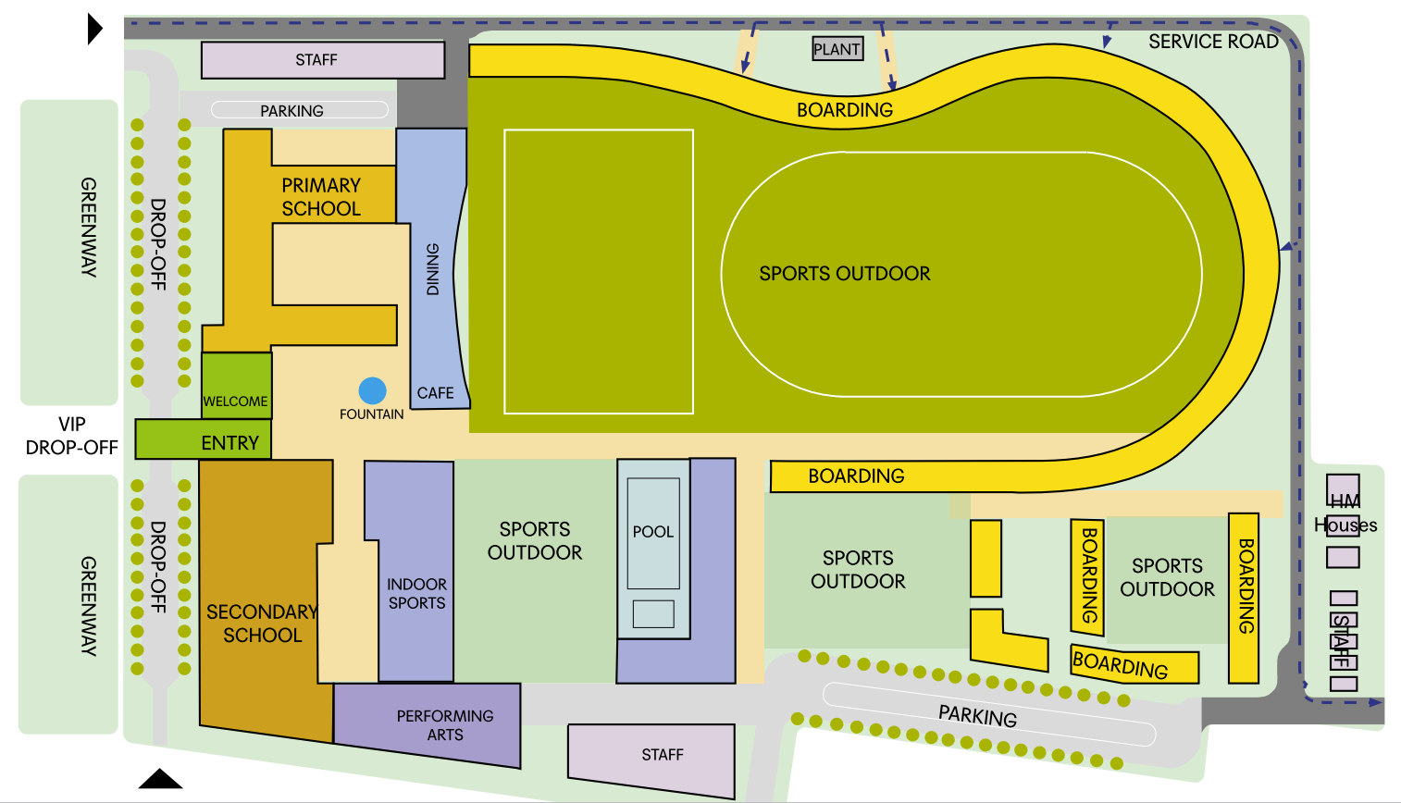
Wellington College International Lagos
Campus Design
WCI Lagos will sit on a 12.5 acre site, comprising of:
Junior School
Senior School
Boarding Houses (Primary, nurturing Senior, Senior)
Performing Arts Center (including 800-seater auditorium)
Sports facilities (including 50m indoor pool, 400m athletics track, two full size sports pitches, indoor sports hall, tennis courst, padel courts and basketball courts).
Dining Hall and Café
Medical Centre
Staff accommodation

Slide 11

Person Specification
Qualifications & Experience
Qualified teacher
Significant senior leadership experience in UK independent and/or international schools, preferably with boarding.
Demonstrated success in founding, growing, or transforming a school.
Strong knowledge of the British curricula (ideally A levels).
Experience with accreditation frameworks and compliance in international education.
Personal Attributes
Skills & Attributes
Visionary, entrepreneurial, and resilient leader able to inspire a new community.
Strong communicator with diplomatic and intercultural competence.
Strategic thinker with sound financial and organisational acumen.
Passionate about holistic education, pastoral care, and student wellbeing.
Committed to diversity, equity, and inclusion in an international context.
Self starter and resilient to establish a new school.

Slide 12
How to apply
Wellington College Lagos is being assisted in this appointment process by the executive search firm Society (www.society-search.com)
Please direct all questions about the role or application process to the same email address below. Suitable candidates will be contacted before the closing date. An appointment will be made, subject to the receipt of satisfactory references and a background check. Only shortlisted candidates will be contacted for interviews.
For more information, please contact Barbara Taylor at Barbara.taylor@society-search.com to book a confidential conversation.
Applications should consist of:
a concise covering letter (ideally no longer than two pages), addressing the criteria in the Person Specification;
an up-to-date curriculum vitae;
names and contact details of three referees (although referees will only be approached at the final stage of the process, and only with your express permission).
General advice on how to write a strong CV and strong covering letter can be found on our website.
To upload your documents via Society’s website, click here. The deadline for receipt of applications is midday (BST) on Monday, 20 October 2025.
• Shortlisted candidates will be invited to interview on Monday, 27 October 2025 and/or Tuesday 28 October 2025. Please note that the time zone in the UK will change to GMT on Sunday 26 October 2025.
• Formal interviews will be held in person at Wellington College, Crowthorne on Tuesday 4 November 2025. Please block this day out in your diary for final confirmation of the interview schedule.
• An organised trip to Lagos, Nigeria for the final selected candidates and their spouses will follow the first round of interviews.

Slide 13
How to apply
An appointment will be made subject to receipt of satisfactory references. The appointed candidate will be offered a salary that is commensurate with their experience and the seniority of their new role.
We are committed to ensuring that anyone can access our application processes. This includes people with hearing, sight, mobility, and cognitive impairments. Should you require access to this document in an alternative format, wish to apply in a different format, or need any other reasonable adjustments made for you (including at interview), please contact us at inclusion@society-search.com. We also welcome suggestions or comments about any more general access improvements we should consider.
Safer Recruitment Policy:
“Aligned with the recommendations of the International Task Force on Child Protection, we hold ourselves to a high standard of effective recruiting practices with specific attention to child protection.”
ITFCP Statement of Commitment:
Please note this position is subject to an enhanced Criminal Records Bureau Disclosure.
Wellington College International, Lagos is committed to equality and diversity. The school is committed to safeguarding and promoting the welfare of children, young people and adults and expects all staff and volunteers to share this commitment. All applicants must be willing to undergo child protection screening, including checks with past employers and Disclosure and Barring Service checks.
References:
Please note that we will wish to contact the referees of all shortlisted candidates. If you have a specific preference that we should not contact someone immediately, please indicate this in your application.

